Slide 1
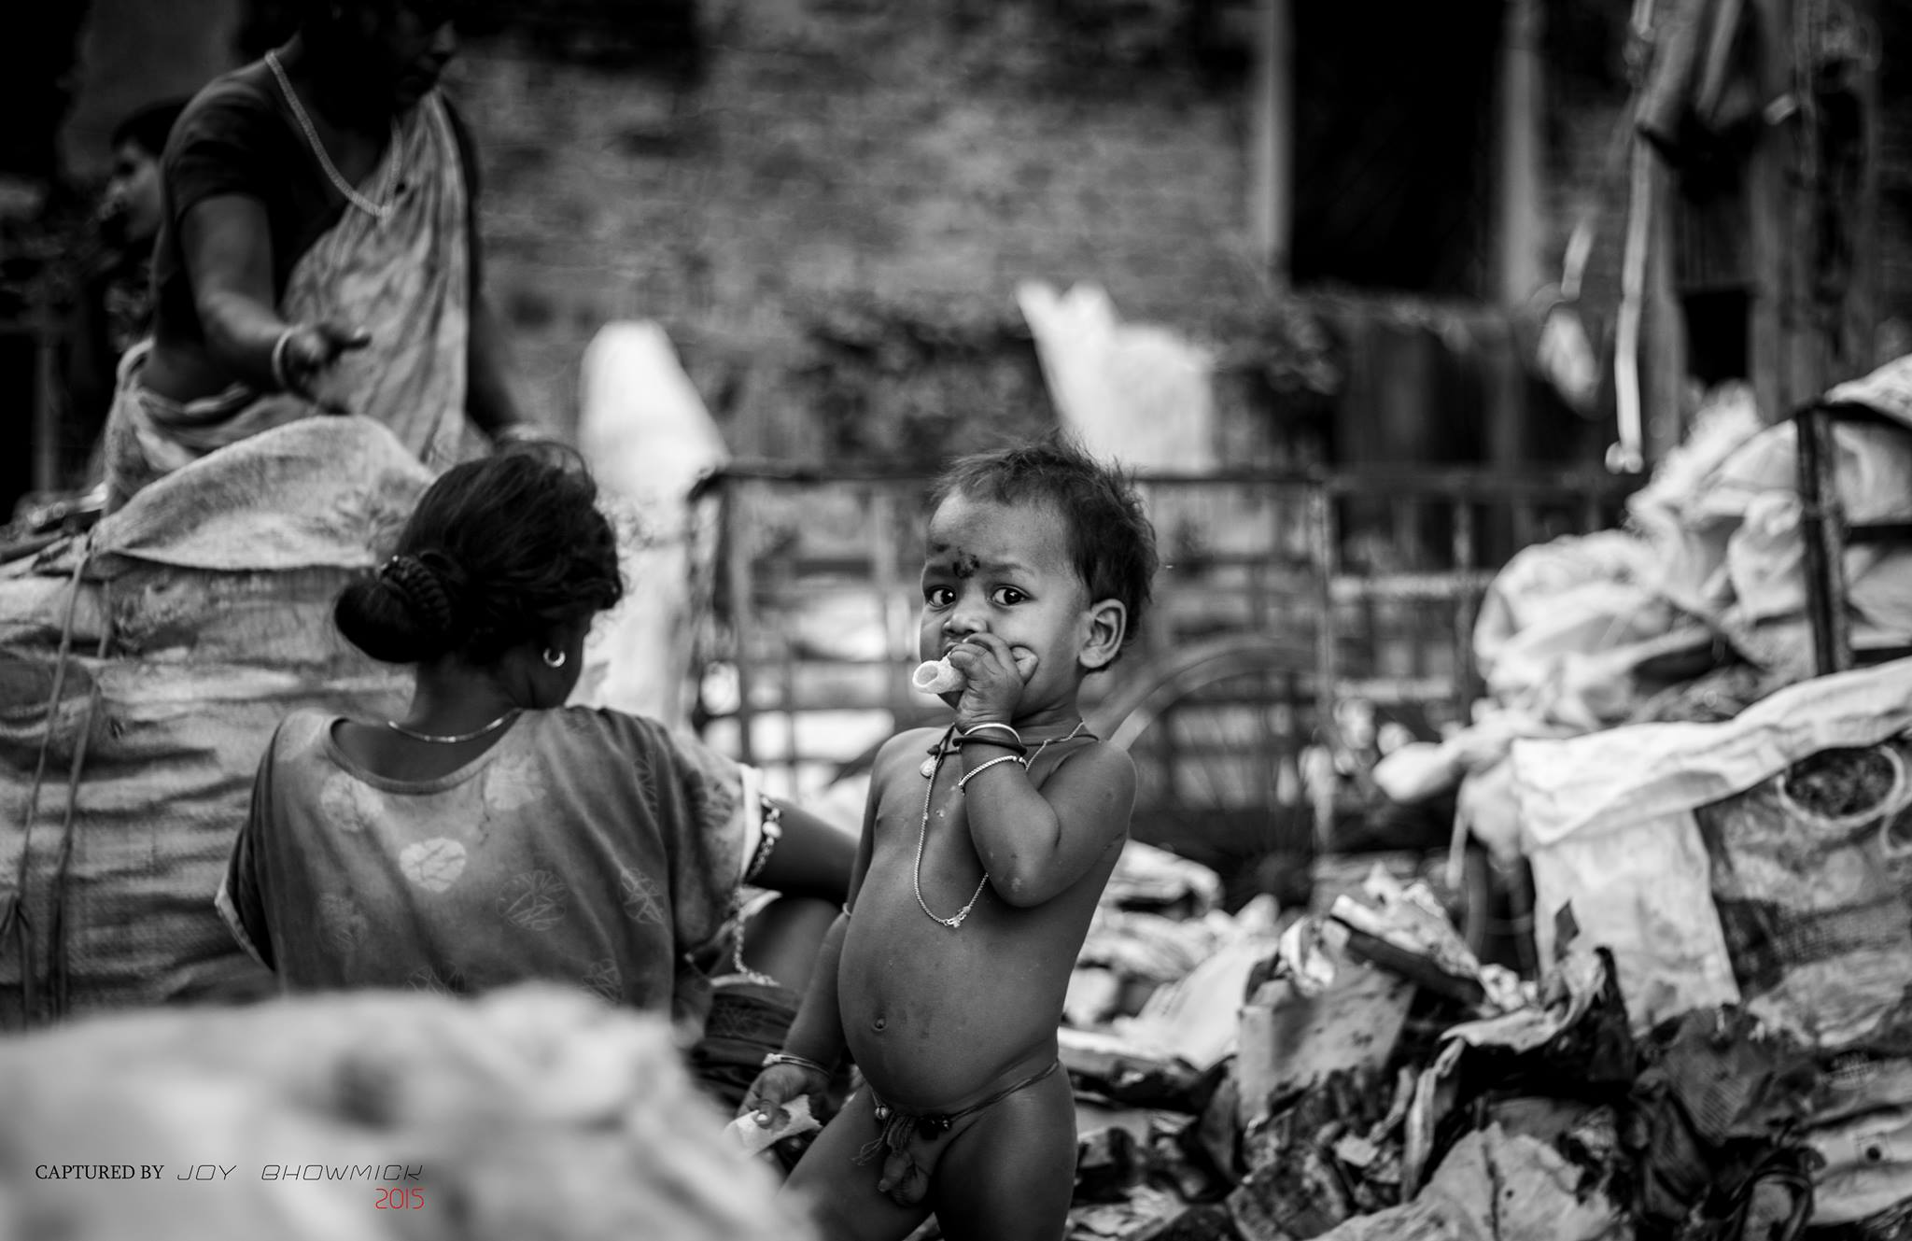

Reducing Hunger Using Machine Learning
Group No. 6
Group Members:
Ally Saha
Antarlin Chanda
Joy Bhowmick
Tamosa Sur

Slide 2
Presentation Topics
Introduction
The Analytics challenge
Business Problem
Business Data
Data Issues & Data Security
Modeling & Evaluation
Deploying
Challenges & Mitigation
Keeping ahead of Competition
Learnings & next steps

Slide 3
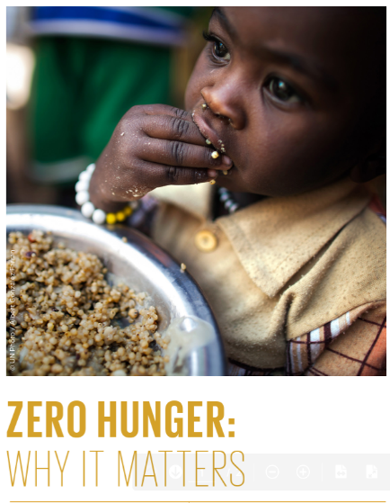
Introduction
India is ranked at 101st position amongst 116 countries on Global Hunger Index in 2021 which is a drop in rank from 96th position last year. According to the food and Agriculture Organization of the United Nations, 189.2 million people are undernourished in India which is 14% of the total population. Thus, the hunger issue is one of the major challenges India faces, which has also increased due to the ongoing pandemic.
We want to address the issue of equally distributing the food from various food outlets to the target audience with the help of proper mapping of these individuals and dividing them into clusters where they live and the size of the cluster city-wise. We can connect the local eateries and their per-day wastage or
free food they can donate based on this data.

Slide 4
Analytics Challenge
Domain Chosen : Food Insecurity
Why this domain is important : For Sustainable growth of humans towards zero hunger.
What kind of impact this domain has?: It is satisfying one of the most basic needs of humans, which the less fortunate people aren’t able to suffice on their own.
Who are the leaders in your domain of choice?: The Robinhood Army, Akshaya Patra Foundation
How the leaders in your domain of choice maintains leadership: They work tediously to provide surplus food to the less fortunate.

Slide 5
Business Problem
What are the Business Problems in your domain of choice: Business Problems in this domain of our choice are mainly focused on bridging the gap between the need and waste. Through the help of Machine Learning, we intend to provide food to the needy in an organized way from sources where food goes wasted on a regular basis. This helps in appropriate resource management through which not just the needy are fed but it leads to proper utilization of the resources of the country which otherwise gets wasted on a regular basis.
Why the problem is important and unique: The problem is extremely important in the sense that part of the population that used to be hungry will get fed leading to overall welfare of the population through which issues like hunger, malnutrition and other food related issues can get addressed. Organizations used to donate food to the less privileged but there was no methodological approach for doing this and they used to do based on guestimates. Our unique approach to this problem is the use of machine learning algorithm to solve the problem of hunger as well as reduction of food wastage. We further want to use Machine Learning to suggest combination of food especially from the voluntary doners in such a way that it fulfills the calorific need an human being based on their age and their current health. This will enable us to not only to provide a meal but also fulfill their body need to complete the overall nutrition requirement, thus curbing the issue of hunger and mal-nutrition that plagues our society.

Slide 6
Business Problem
Who are the stakeholders which gets impacted by the problem: Stakeholders impacted in this problem are the hotel, hostel authorities, voluntary donors, religious places authorities, NGOs, Volunteers who are our sources and the people who are helped though this approach and the people involved in analytics sector who help in bridging the gap.
The potential benefit of solving the business problem: The potential benefit of solving this business problem mainly goes to the needy whom we are trying to feed and it leads to tremendous reduction of wastage of resources. This will lead to reaching of sustainable resource management of potential reduction of hunger.

Slide 7
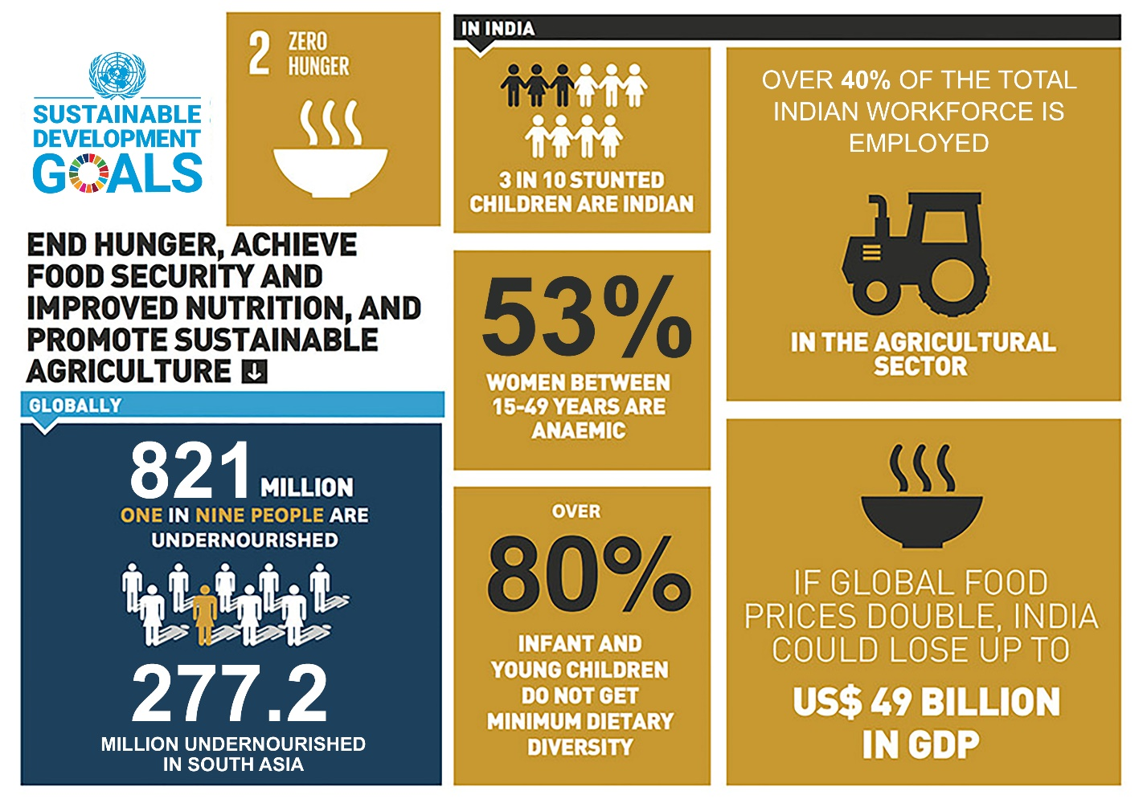
Business Problem

Slide 8

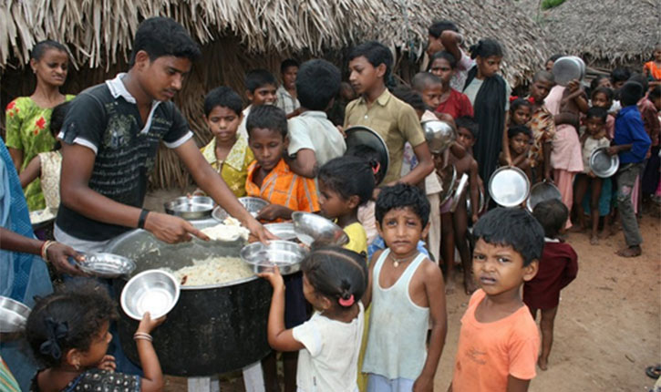
Business Data(Source)
Temples and mosques and other such religious places who are inclined towards food donations. We can get data about how many people they cater to and what is their frequency.
Individual donors’ data can be mapped from various NGO s or through proposed apps.
Various hotels and eateries can again be captured both from the proposed app as well as the NGOs who are frequently providing food on a regular basis.
Various organization do these CSR initiatives and even individuals also, we will provide analytics so that they can better manage their CSR activities.

Slide 9
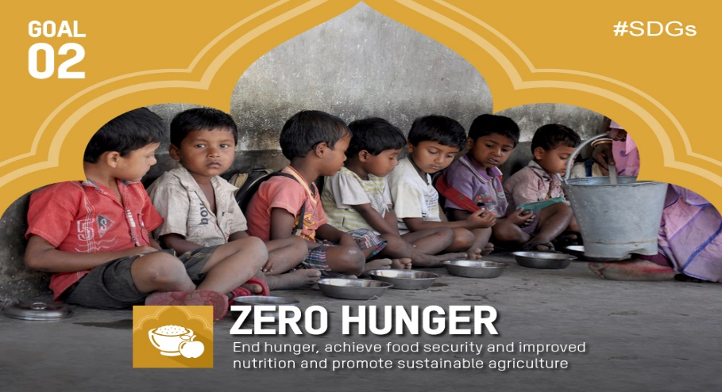
Business Data(Demand)
Government Data, NGO data can help to provide the proper locations for homeless people and other persons who need meals or go hungry every day.
Security cams, traffic cams, and such others can be used to locate areas where such people reside or new ones are being added.

Slide 10


Potential Data Issues including Security
Data related to various below poverty line area clusters if gets breached with bad intentions can lead to heinous crimes such as child labor and human trafficking. Our collection of data related to such places can give easy resources to human traffickers.
Imposters can be a disastrous threat arising due to breach of security. If data related to all the participants participating in the donation process gets leaked, then imposters can easily take away what is meant for the needy.

Slide 11
Transition of the business problem to data science problem
We can try to solve the above business problem with the use of analytics. The transition can be done as follows:
We can make a minimalistic front-end through which we will be able to get information regarding various hotels, eateries and probable sources from where we can get food.
The data once uploaded on server can be further used for modelling and evaluation purposes.

Slide 12
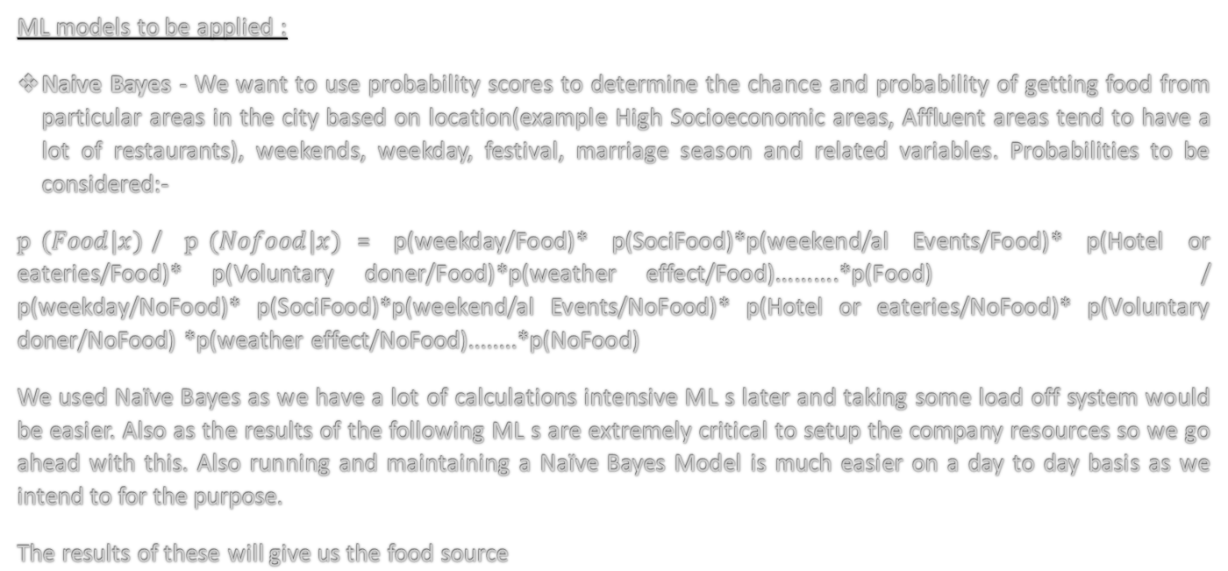
Modelling & Evaluation
ML models to be applied :
Naive Bayes - We want to use probability scores to determine the chance and probability of getting food from particular areas in the city based on location(example High Socioeconomic areas, Affluent areas tend to have a lot of restaurants), weekends, weekday, festival, marriage season and related variables. Probabilities to be considered:-
p$(Food|x)$/ p$(Nofood|x)$= p(weekday/Food)* p(SociFood)*p(weekend/al Events/Food)* p(Hotel or eateries/Food)* p(Voluntary doner/Food)*p(weather effect/Food)..........*p(Food) / p(weekday/NoFood)* p(SociFood)*p(weekend/al Events/NoFood)* p(Hotel or eateries/NoFood)* p(Voluntary doner/NoFood) *p(weather effect/NoFood)........*p(NoFood)
We used Naïve Bayes as we have a lot of calculations intensive ML s later and taking some load off system would be easier. Also as the results of the following ML s are extremely critical to setup the company resources so we go ahead with this. Also running and maintaining a Naïve Bayes Model is much easier on a day to day basis as we intend to for the purpose.
The results of these will give us the food source

Slide 13
Modelling & Evaluation(Continued)
The results of these will give us the food sources
Clustering - Find out clusters of high food area demand due to poverty. We can find out areas of most needy people by using cluster analysis on people residence areas. Census, Socio Economic Criteria, High population density, lower-income areas, literacy levels, lack of healthcare, sanitation, slum locations, these data can be fed into a clustering method to find out the most malnourished areas which are of prime importance and concern to us. Then this data can be identified through clustering so that we can channelize our food distribution efforts.
The results of these will give us the food delivery destinations.

Slide 14
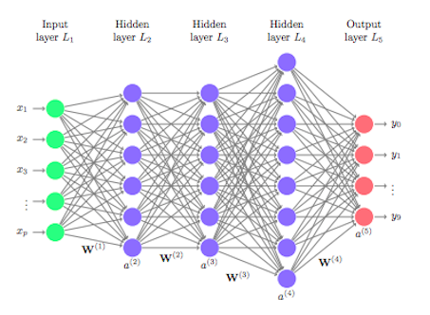
Modelling & Evaluation(Continued)
Deep Learning - When we are getting some extra or lot of food we want to use ML/AI to determine the nutritional value of foods through Deep Learning Image Identification and mix and match foods based on nutrition value and then distribute. We know how much protein or calcium people need in a meal to lead a normal life and we may somewhat try to ensure they get the maximum nutritional value out of food even though it may of 1 meal.

Slide 15
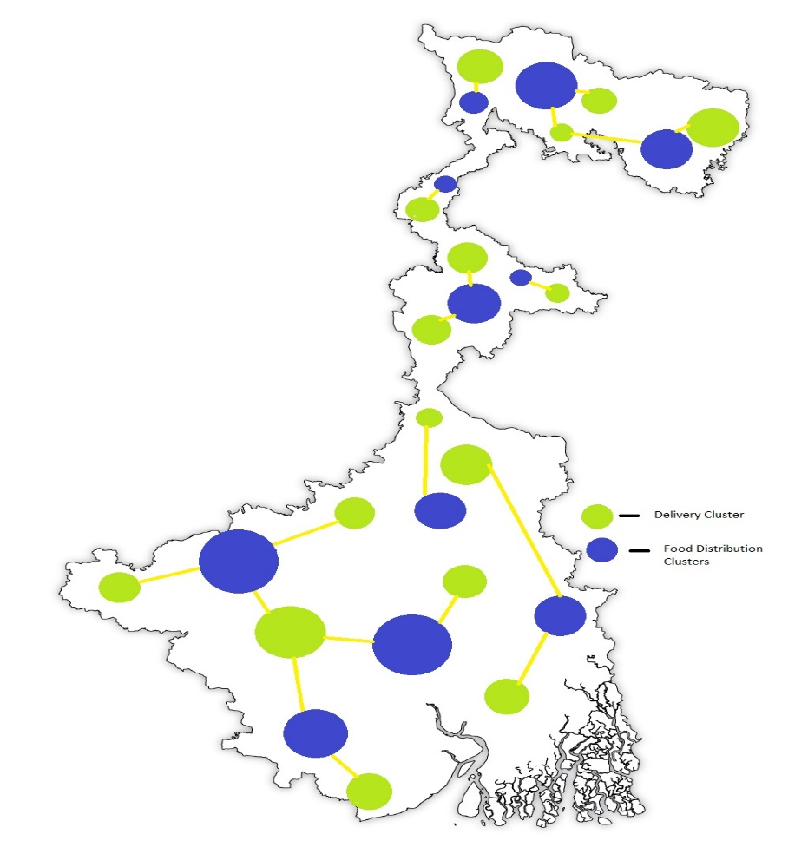
Clustering

Slide 16
Deployment
Donor details collection can be done through a website, where anybody willing to donate the surplus food can provide the necessary data for us to reach them. The model would be deployed over public cloud provided by Cloud Service Providers. Examples are Azure, Amazon Web Services, and Google Cloud Platform. All the necessary model calculation portions will be done in the Cloud platform. So no load on local machines. We will follow a subscription-based model with the CSP s.
We will have all the datasets connected to our individual ML models. The results of the model will be visible to us through a frontend GUI so that it is easily accessible to the important players in the company.
We will have a website setup for frontend interaction with the server so that we can use daily based activities e
We will be using Cloud Storage to store the data and use Azure Machine Learning for maximum flexibility.

Slide 17
Challenges & Mitigation
Major challenges we are facing in this approach:
High-Level Restaurants are reluctant to give away their food due to standards. This may cause a major hindrance in the supply of food(refence added in reference slide). Thus, need to on-board such hotels and hostel’s mess which has no such obligation and are willing to help in this endeavor.
Quality of food given should be of good quality. This can be regulated if the food items for distribution are checked manually by the volunteers before distribution to the community.
We also need to collect data of individuals who are in the receiving end of the service so that we can use ML to cater to their calorific needs. This will be a time consuming issue which was attract time and cost for the same.
Since our aim is mainly to feed the needy and simultaneously reduce wastage of food to an extent, we might face a lot of problems in rural areas because of the lesser availability of organized restaurants, hotels, and hostels. To solve this issue we need to do a detailed search on the possible food sources available such as local dhabas or small hotels. The initial search could be time-consuming.

Slide 18
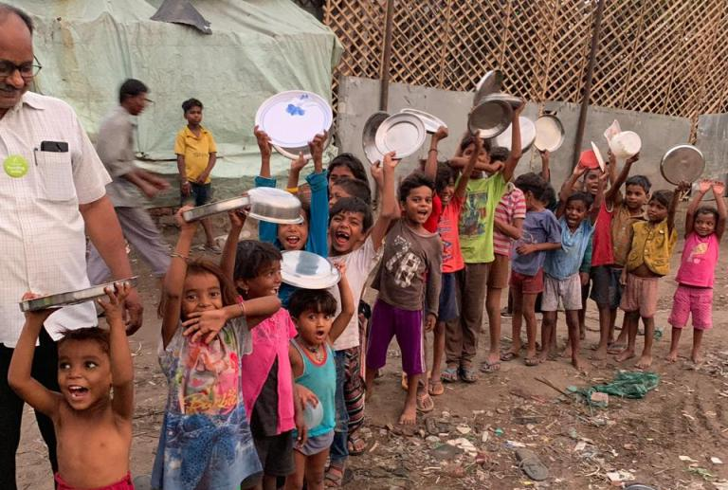
Keeping ahead of Competition
We would enhance our models with data in a continuous process so that we can maximize the reach of food to the underprivileged section of the society as well as regularize this process in such a way that they receive one meal per day at-least. We are not only aiming to reduce hunger to the minimum we also plan to provide meals to the needy which are more than a one time meal but a whole full calorific food that a human body needs according to age, gender, nursing mothers and other such factors. Thus, taking care of not only the hunger issue but also the nutritional aspect of the individuals can greatly benefit the society as the whole.
This will allow us to stay abreast of our competition and serve the underprivileged to build a better society which is devoid of hunger and malnutrition, thus using data for good.

Slide 19
Learnings & future plan
The future plan of the project is not only to restrict to supply of excess cooked food but also to supply food grains/ uncooked food from the unclaimed ration shops. Collection of the same can be done via ration shops and using our model we can distribute the same. This will allow the individuals at the receiving end of the service to not only relay on one source of food supply.
Also food distribution truck travel time optimizations work planned.

Slide 20
References
Attached is some References and guiding materials used for our project
https://www.avanade.com/en/media-center/press-releases/cloud-data-analytics-transform-the-felix-project
https://www.akshayapatra.org/
https://robinhoodarmy.com/
https://timesofindia.indiatimes.com/what-do-restaurants-do-with-leftover-food/articleshow/39099560.cms/

Slide 21

Celebrate Your Worth
http://www.praxis.ac.in

